Slide 1


Attrition Case Study Zachary Harris

Slide 2
Project analysis slide 2
Overview
7
1
Conclusion
Overview
Attrition Case Study
6
2
Predicting
Insights and Discoveries
5
4
Modeling
Classifying

Slide 3
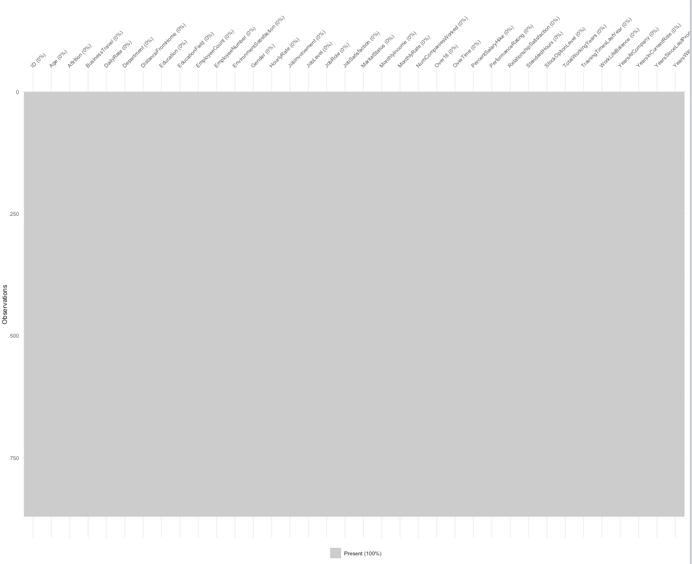
Project analysis slide 3
Insights and Discoveries
Preparing the Data
Summary of Data
Number of Observations | 870
Number of Variables | 36
Missing Values | 0
Vis_miss()
Using the vis_miss() function, we are able to determine if the data set has any missing values. Since this data set does not, there is no need to impute any values.

Slide 4
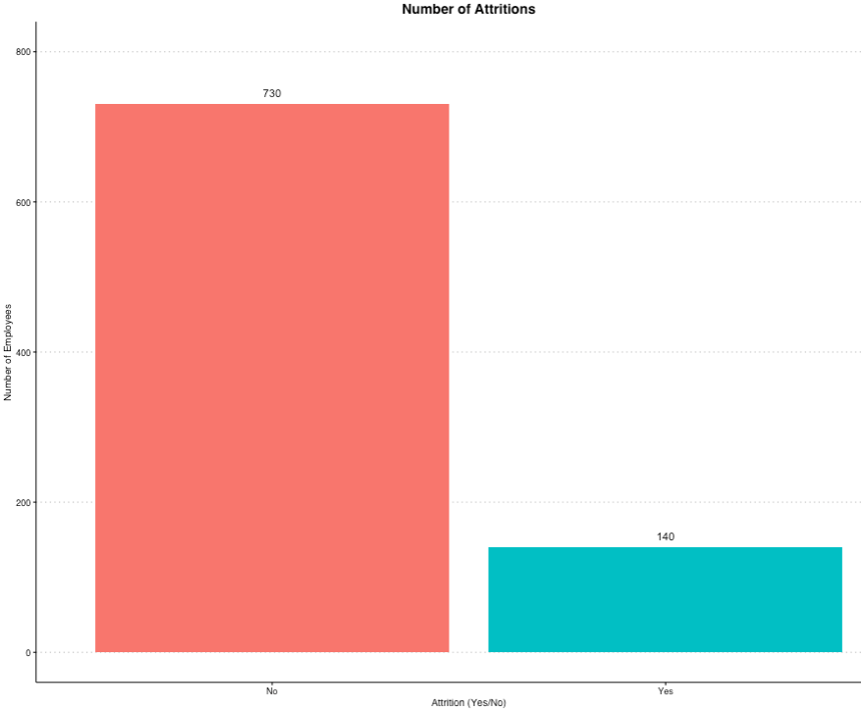
Project analysis slide 3
Insights and Discoveries
Examining the Data
Summary of Data
Number of Observations | 870
Attrition - Yes | 140
Attrition - No | 730
ggplot()
We began visualizing the data by first seeing how many employees experienced attrition versus those who did not. About 16% of the people in the data set experienced attrition.

Slide 5
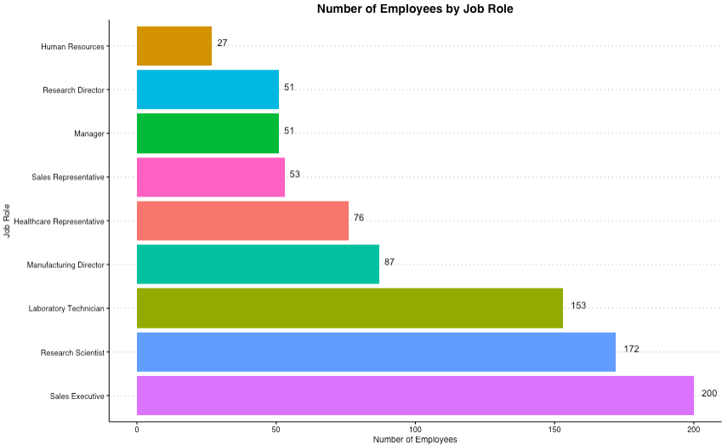
Project analysis slide 3
Insights and Discoveries
Examining the Data
# of Employees
This chart shows the number of people by job role. This was conducted simply to show the distribution of the people in each job role.

Slide 6
Project analysis slide 3
Insights and Discoveries
Examining the Data
Attrition and Job Role
This chart shows the number of people by job role broken down by attrition

Slide 7
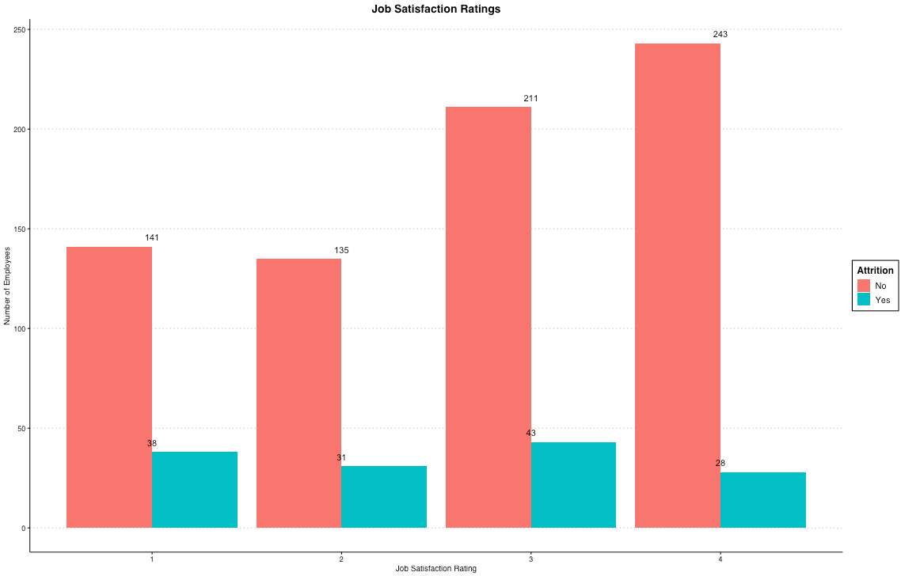
Insights and Discoveries
Examining the Data
Attrition Rate
Rating | Yes | No | Rate
1 | 38 | 141 | .2695
2 | 31 | 135 | .2296
3 | 43 | 211 | .2038
4 | 28 | 243 | .1152
The attrition rate is found by dividing the number of people who experienced attrition by the number of people who did not. For this variable, the data suggest that as the rating for Job Satisfaction increases, the attrition rate decreases. This trend can be found in the next four satisfaction variables.

Slide 8
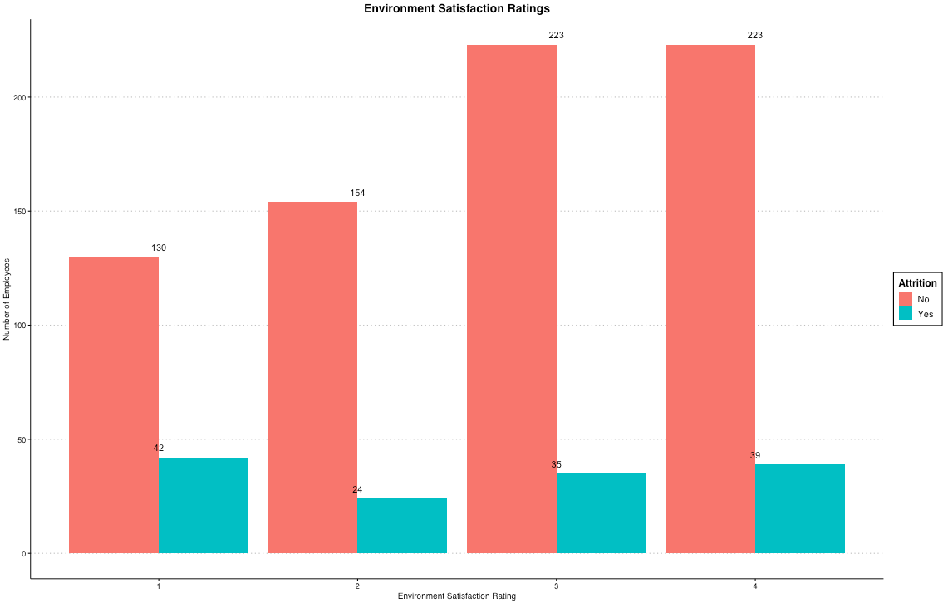
Insights and Discoveries
Examining the Data
Attrition Rate
Rating | Yes | No | Rate
1 | 42 | 130 | .3231
2 | 24 | 154 | .1558
3 | 35 | 223 | .1570
4 | 39 | 223 | .1749

Slide 9
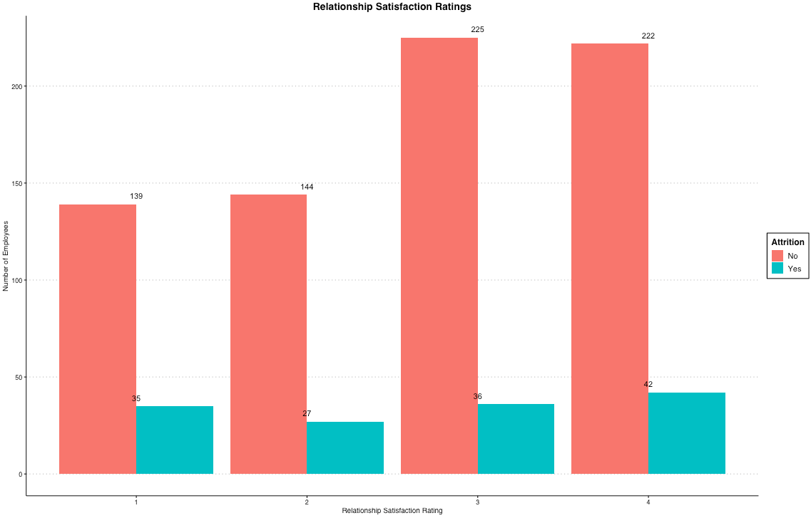
Insights and Discoveries
Examining the Data
Attrition Rate
Rating | Yes | No | Rate
1 | 35 | 139 | .2518
2 | 27 | 144 | .1875
3 | 36 | 225 | .1600
4 | 42 | 222 | .1892

Slide 10
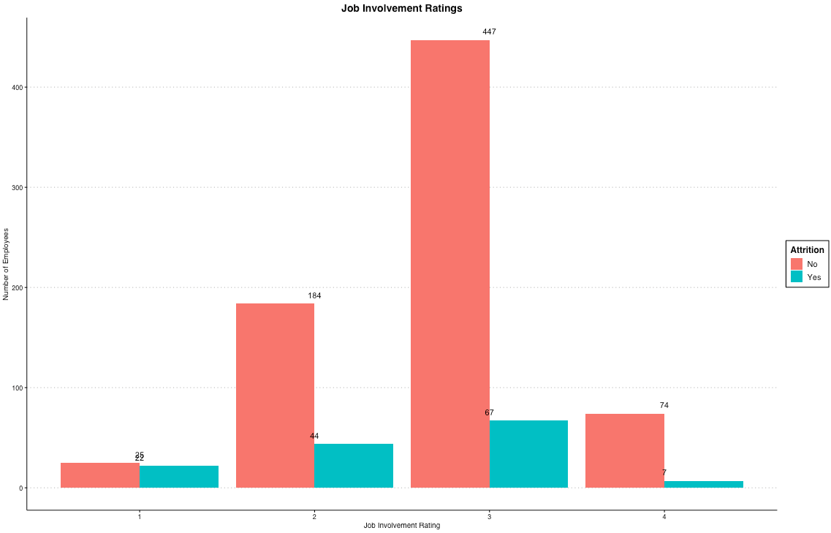
Insights and Discoveries
Examining the Data
Attrition Rate
Rating | Yes | No | Rate
1 | 22 | 25 | .8800
2 | 44 | 184 | .2391
3 | 67 | 447 | .1499
4 | 7 | 74 | .0946

Slide 11
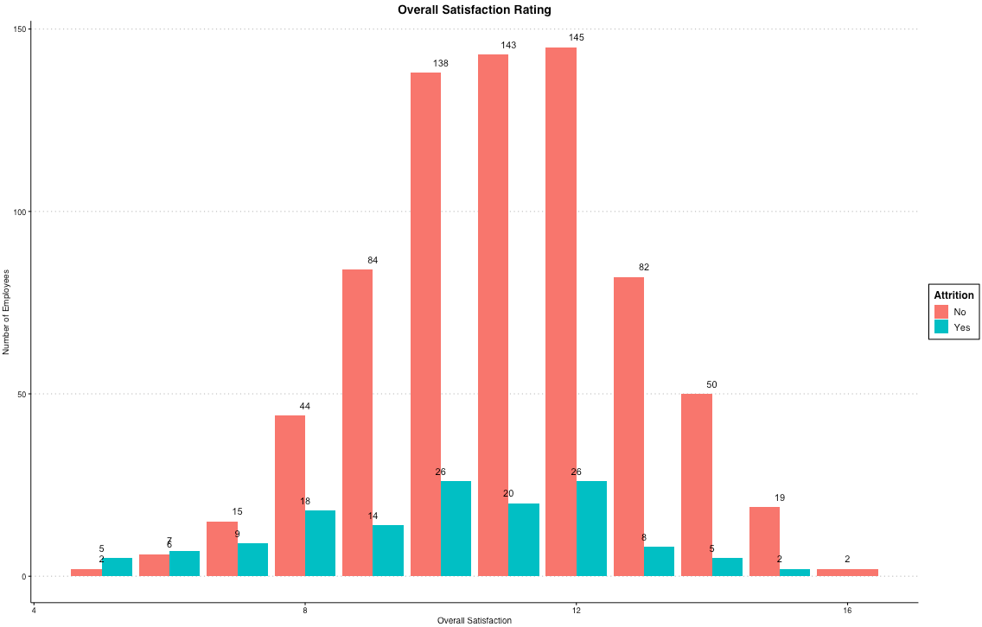
Insights and Discoveries
Examining the Data
Overall Satisfaction
A new variable was created called Overall Satisfaction

Slide 12
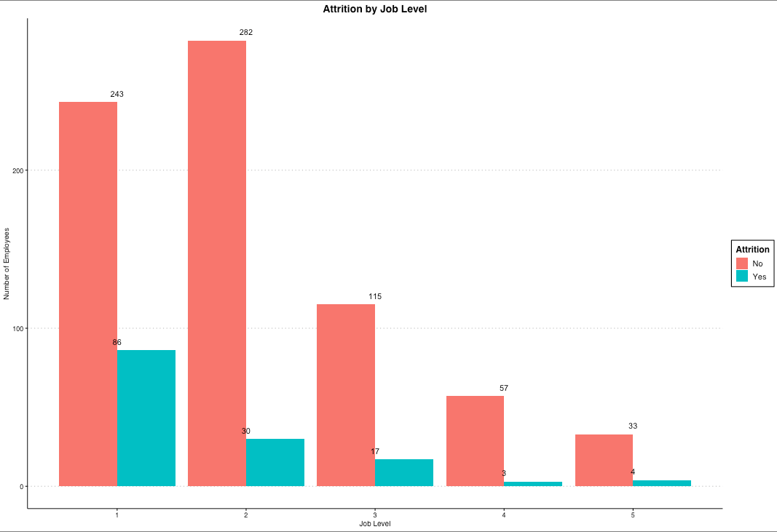
Insights and Discoveries
Examining the Data
Attrition Rate
Level | Yes | No | Rate
1 | 86 | 243 | .3539
2 | 30 | 282 | .1064
3 | 17 | 115 | .1478
4 | 3 | 57 | .0526
5 | 4 | 33 | .1212
Job Level
A downward trend in Attrition Rate can be found with increasing Job Level.

Slide 13
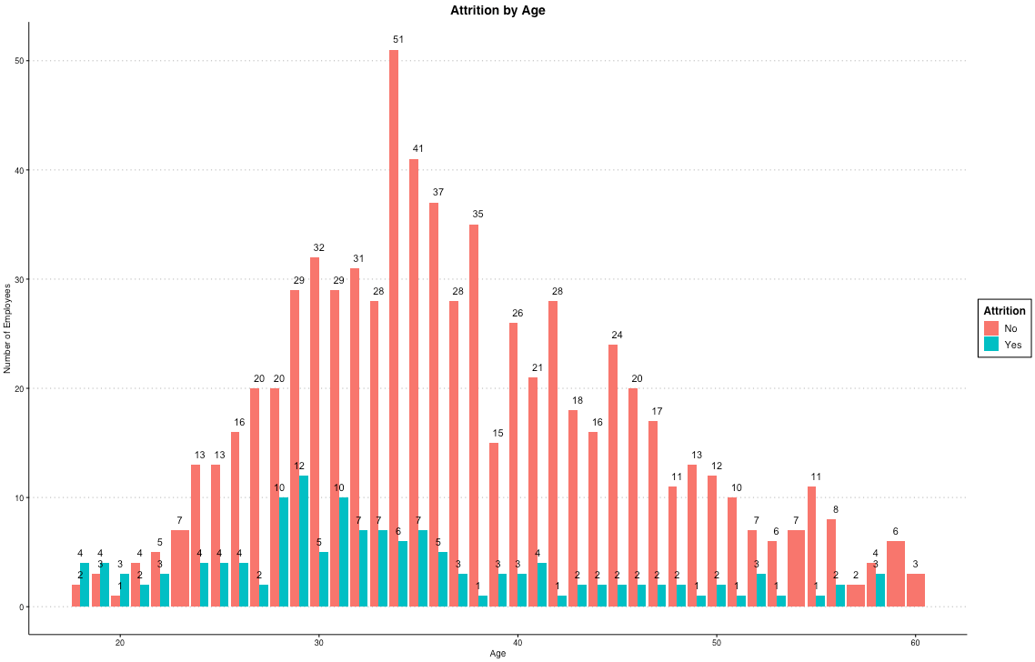
Insights and Discoveries
Examining the Data
Attrition by Age
As age increases, the attrition rate appears to decrease.

Slide 14
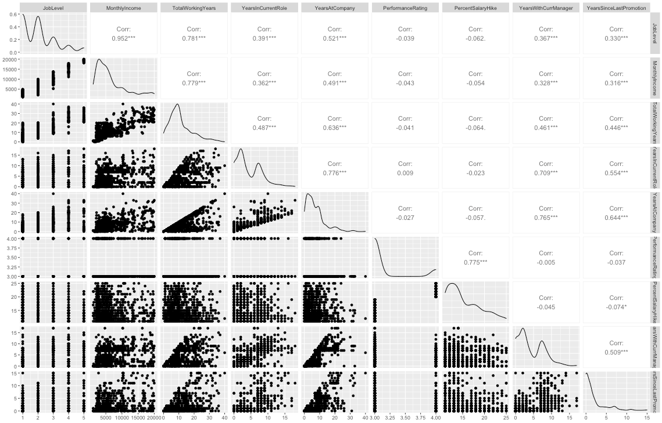
Project analysis slide 4
Insights and Discoveries
Examining the Data
High Correlation
The table to the right shows some high correlation variables. Particularly, we are interested in anything over .50.

Slide 15
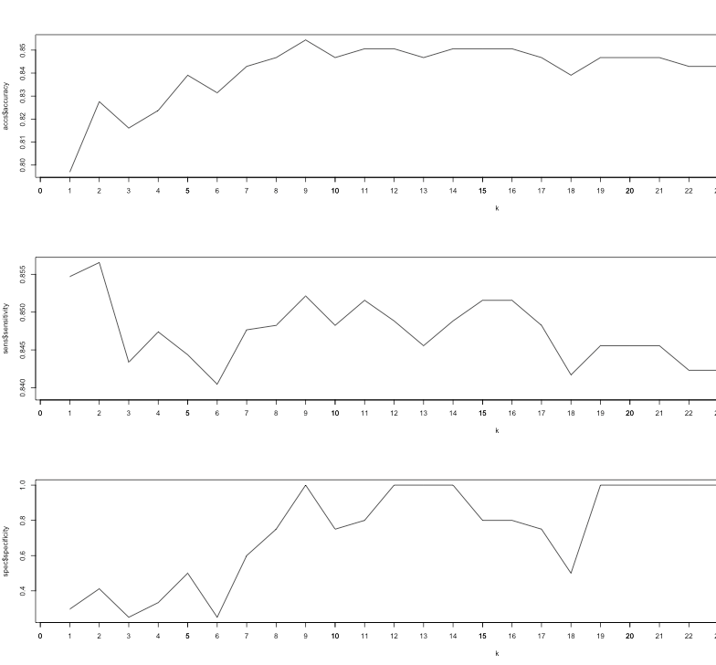
Classifying
Determining Variables and Prediction Success
kNN
This model shows that we ran test on the model thirty times. Each time, we increased the value of k by one unit to find the best k. We settled on 13. Even though it may not be the best for this set of iterations, 13 performed well in singular test as well as this test.

Slide 16
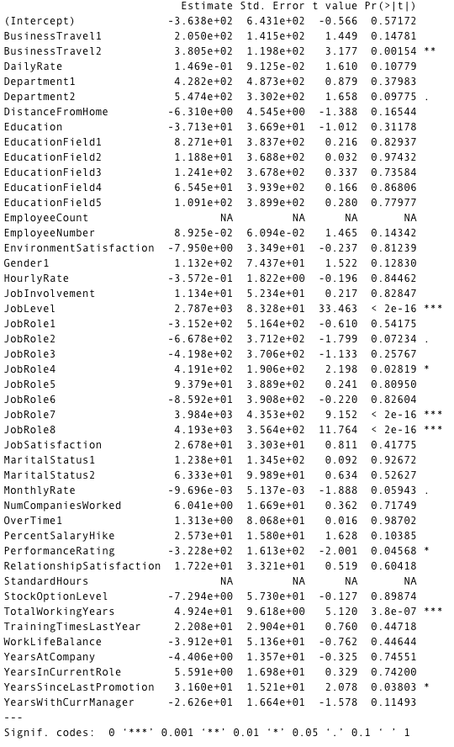
Project analysis slide 10
Modeling
Selecting Variables
Selected Variables for Model
BusinessTravel
JobLevel
JobRole
YearsSinceLastPromotion
Selecting Variables
Any variable that had a p-value of less that .05 remained in the model. Anything above that threshold was eliminated because a p-value of more than 0.05 indicates an insignificant impact on the model.

Slide 17
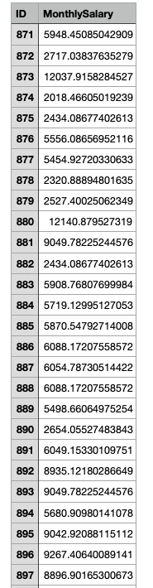
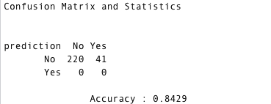
Predicting
Determining Variables and Prediction Success
Regression
kNN Classifier
Predictions
Predictions and outputs were saved to .csv files and are awaiting comparison to determine if models perform well.

Slide 18
Thank You
Please email all questions and concerns to zharris@smu.edu.

